Slide 1
Assessment of radar detection performance using design of experiments; A case study
Luis A. Cortes, P.E.
Darryl Ahner, P.E., Ph.D.
OSD STAT COE
www.AFIT.edu/STAT
937-255-3636 x 4736
Scientia Prudentia et Valor
DISTRIBUTION STATEMENT A: Approved for public release; distribution is unlimited.

Slide 2
Bottom Line Up Front
This case study is an application of experimental design to the test and evaluation of surface radars.
It builds upon previous work done by the Naval Surface Warfare Center, Corona Division.
We look back into a test considered a landmark in M&S-based acquisition and contrast the evaluation of some objectives to the potential of using experimental design.
In the process, we explore the attributes of a well designed test and demonstrate the utility of experimental design for planning, designing, executing, and analyzing a test.
What could we have done differently?
An experimental design approach would have contribute
to making the test more robust, efficient, and cost effective.

Slide 3
Test Background
Test Operations
Evaluate detection performance for a class of threat representative targets*
Factors involved
Three target factors - A, B, F
Two environmental factors - C, D
One system factor - E
Test strategy
96 possible treatments
30 samples per treatment required
2880 total runs required
96 hrs of test required-not enough time!
670 runs conducted
Assessment criteria - Pass/Fail
An accredited federation of robust models and simulations replicated the at-sea conditions
Test events
80 hrs total test time
18 hrs of manned aircraft raids
110 electronic attack (EA) techniques
1900 simulated Anti Ship Cruise Missiles
One Objective
Sacrificed statistical confidence due to test time limitations.
Had an informal criteria for selecting test runs.
Analysis limited to pass/fail.
*Other objectives are beyond the scope of this brief; however, similar lessons apply.

Slide 4
Tradeoff Space
Risk of accepting
a “bad” system
Adequate
sample size
Effects on
performance
Risk of rejecting
a “good“ system
The Central Problem of Test is to determine the true nature of the system, in all possible scenarios, with a finite number of samples that yield valid conclusions while minimizing the risk of error.

Slide 5
Experimental Design Guidelines*
Formulate a clear statement of the problem.
Identify the proper responses to be analyzed.
Identify the factors and their levels.
Plan
4. Choose an appropriate experimental design.
Design
5. Perform the test as outlined in the test matrix.
Execute
Execute
6. Perform the appropriate statistical data analysis.
7. Reach valid and practical recommendations.
Analyze
* Montgomery, D. C. (2013), Design and Analysis of Experiments,8th ed., John Wiley & Sons.

Slide 6
Experimental Design Approach Step 1 - Problem Definition
Performance Requirements
Statistical Parameters
Confidence level (α) - 0.05
Effect to detect (δ) – based on performance expectations
Variability (σ) - based on historical data
S/N (δ/σ) - 1.00 (for the case study)
+
E
–
C
–
+
A
D
B
We want to evaluate the effect of five factors* on detection performance.
*Six factors were of interest, but data for one factor was incomplete; therefore, the study was limited to five factors.

Slide 7
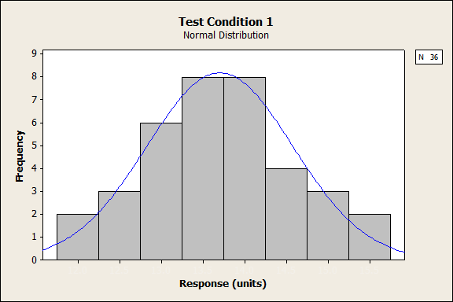
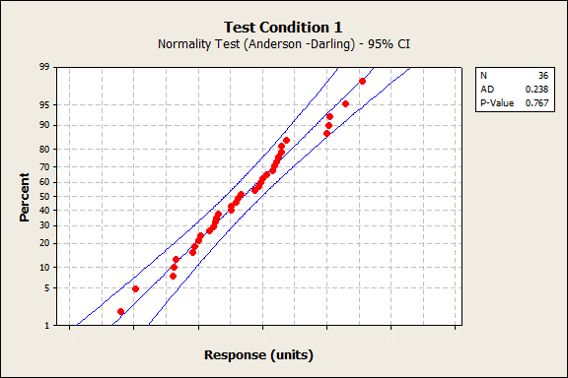
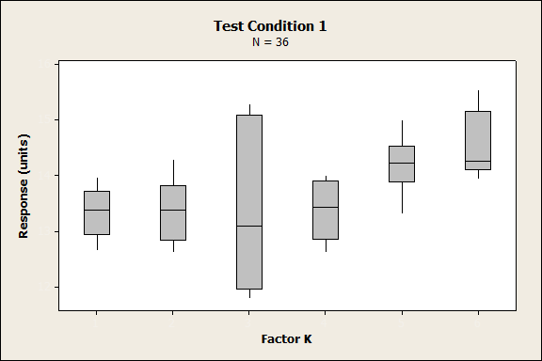
Experimental Design Approach Step 1 - Historical Data Analysis
Analysis of historical data adds rigor to test planning.
Test Condition 1
Paired T-test for Difference of Means (K_{i} – K_{j})
 |  | 1 | 2 | 3 | 4 | 5 | 6
 | 1 | - | X | X | X | X | X
 | 2 | - | - | X | X | X | X
 | 3 | - | - | - | X | X | X
 | 4 | - | - | - | - | X | X
 | 5 | - | - | - | - | - | X
 | 6 | - | - | - | - | - | -
Alpha = 0.05; x = p-value < 0.05

Slide 8
Experimental Design Approach Steps 2 & 3 - Responses and Factors
Continuous factors are preferred.
A single design can be used to evaluate multiple responses.
Covariates
Search Times, Power, Sensitivity, Material Readiness
Factors
Responses
A (Continuous, 3-levels)
R1-Detection range
B (Categorical, 2-levels)
C (Categorical, 2-levels)
R2-Transition-to-track range
D* (Categorical, 2-levels)
R3-Firm track range
E* (Categorical, 2-levels)
F^ (Fixed)
R4-Engagement Range
Select appropriate factors.
Continuous responses are preferred.
Noise
* For large designs, these are hard(er)-to-change factors
^ Fixed during the original test due to test time limitations

Slide 9
Experimental Design Approach Step 4 – Select a Design
Some Experimental Design Alternatives
Completely Randomized Designs; Model – ME + 2FI; Power (1 std. dev.) at α = 0.05
Design | Runs | Center Points | Power (%) (ME) | VIF | DOF |  |  | Std. Error
 |  |  |  |  | Model | LOF | PE | (FDS=0.8)
MR-Res IV | 12 | 0 | 27-28 | 1.1 - 7.0 | 10 | 1 | 0 | 1.5
MR-Res IV | 92 | 5 | 39-99 | 1.0 – 1.5 | 15 | 12 | 64 | 0.7
2_{V}⁵⁻¹ | 16 | 0 | - | 1.0 | 15 | 0 | 0 | -
2_{V}⁵⁻¹ | 96 | 5 | 50–98 | 1.0 | 15 | 16 | 64 | 0.6
D-Optimal | 21 | 0 | 54–57 | 1.1 | 15 | 5 | 0 | 1.0
2⁵ | 32 | 0 | 76 | 1.0 | 15 | 16 | 0 | 0.7
2⁵ |  | 5
2 x 2⁵ | 64 | 0 | 97 | 1.0 | 15 | 16 | 32 | 0.5
2 x 2⁵ | 144 | 5 | 98-99 | 1.0 | 15 | 32 | 96 | 0.4
4 x 2⁵ | 192 | 4
Legend:
ME – main effects 2FI – two factor interactions
DOF – degrees-of-freedom VIF – variance inflation factor
LOF – lack-of-fit PE – pure error
FDS – fraction of the design space
Evaluate several designs and select one that is appropriate for the problem and that has good properties.

Slide 10
Experimental Design Approach Step 4 – Design Selection
Case I: 2_{V}⁵⁻¹ fractional factorial
16 runs
No degrees of freedom for estimating pure error, lack-of-fit, or test of significance
Case II: 2⁵ factorial (2x)
32 runs
No center points
Case III: 2⁵ factorial + center point (4x)
192 runs
Center points allow testing for curvature and estimating pure error.
+
E
–
C
A
–
D
+
B
Are these designs adequate?
+
E
–
C
A
–
D
+
B
+
E
–
C
A
–
D
+
B

Slide 11
Experimental Design Approach Step 5 – Execution
Run the test as specified in the test matrix.
Replicate, Randomize, and Block whenever possible.
Partial Test Matrix For Case III (2⁵ factorial + center points; 4 replicates)
Run Order | Std. Order | Block | A | B | C | D | E | y
96 | 1 | Blk1 | 1 | B2 | C2 | D1 | E1 | xxx
35 | 2 | Blk1 | -1 | B1 | C1 | D2 | E1 | xxx
101 | 3 | Blk1 | 1 | B1 | C2 | D2 | E1 | xxx
46 | 4 | Blk1 | 1 | B2 | C1 | D2 | E1 | xxx
32 | 5 | Blk1 | 1 | B2 | C2 | D1 | E1 | xxx
107 | 6 | Blk1 | -1 | B2 | C1 | D2 | E2 | xxx
89 | 7 | Blk1 | 0 | B1 | C2 | D2 | E1 | xxx
……. | ……. | ……. | ……. | ……. | ……. | ……. | ……. | …….
56 | n | Blk1 | 1 | B2 | C2 | D1 | E1 | xxx
……. | ……. | ……. | ……. | ……. | ……. | ……. | ……. | …….
192 | 192 | Blk2 | -1 | B1 | C1 | D1 | E1 | xxx

Slide 12
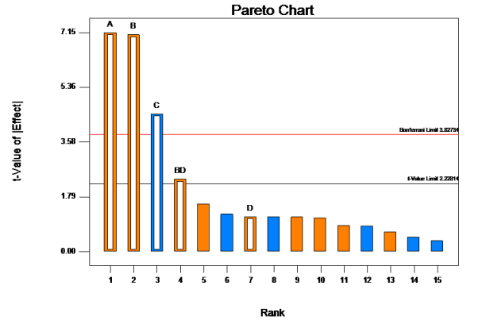
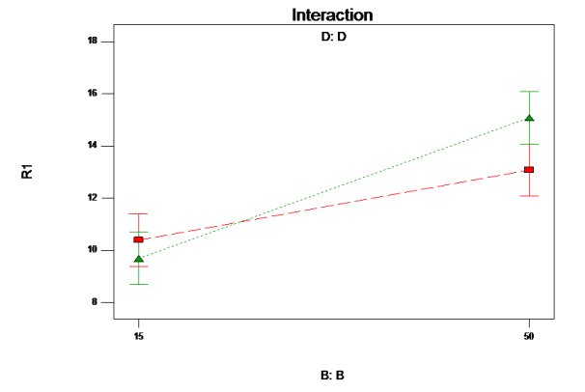
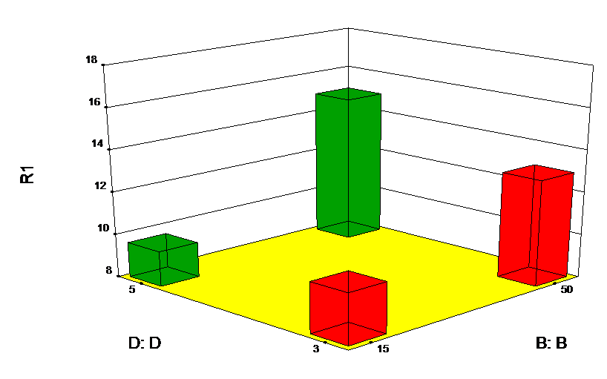
Experimental Design Approach Step 6 - Statistical Analysis (Case I)
Factor D is not significant—a model is suspect.
Analysis of Variance Table for Case I (2_{V}⁵⁻¹Fractional Factorial); p-value <0.1
Sum of Mean F p-value Source Squares df Square Value Prob > F
Model 167.26 5 33.45 25.70 < 0.0001 significant
A-A 66.59 1 66.59 51.15 < 0.0001 B-B 65.29 1 65.29 50.15 < 0.0001 C-C 26.37 1 26.37 20.26 0.0011 D-D 1.70 1 1.70 1.31 0.2794 BD 7.32 1 7.32 5.62 0.0392 Residual 13.02 10 1.30 Cor Total 180.28 15
Experimental design affords studying interactions.
Reduced Empirical Model (Coded Factors)
R1 = I + x₁A + x₂B - x₃C+ x₄D + x₂₄BD
R² = 0.9278 Adj. R² = 0.8917 Pred. R² = 0.8151 Adeq. Precision = 17.23
Reference Mechanistic Model
The empirical model is useful for tactical decision aids, training, and performance assessment.

Slide 13
Experimental Design Approach Step 6 - Statistical Analysis (Case I)
Only factors A, B, and C and interaction BD are significant; factor E is dropped from consideration—the sparsity of effects principle.
A Res V fractional factorial design contains a complete factorial in any subset of 4 factors—the projection property.
We can combine the runs of fractional factorials to assemble a larger design (two blocks)—sequential experimentation
2_{V}⁵⁻¹ Fractional Factorial
2⁴ Factorial
Sparsity of effects
Projection property
Sequential experimentation
+
E
–
–
D
+
C
C
A
A
–
D
+
B
B
Dof for evaluation; model – ME + 2FI Model 15 Residuals 0 Lack Of Fit 0
Pure Error 0 Total 15
Unable to calculate power
Dof for evaluation; model – ME + 2FI Model 10 Residuals 5 Lack Of Fit 5 Pure Error 0 Total 15
Power – 37% (1 std. dev.);
89% (2 std. dev.)

Slide 14
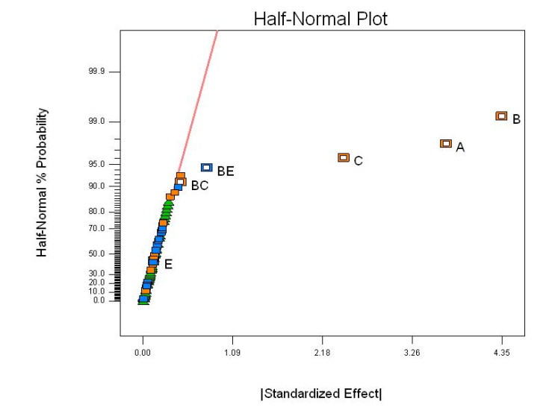
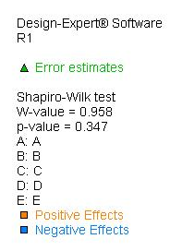
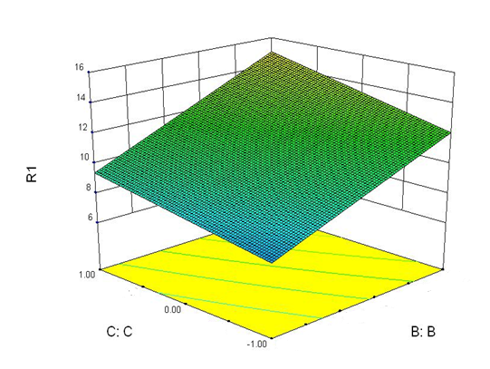
Experimental Design Approach Step 6 - Statistical Analysis (Case II)
Analysis of Variance Table for Case I (2_{V}⁵⁻¹Fractional Factorial); p-value <0.1
Sum of Mean F p-value Source Squares df Square Value Prob > F
Model 627.68 6 104.61 139.00 < 0.0001 significant
A 216.38 1 216.38 287.51 < 0.0001 B 303.20 1 303.20 402.85 < 0.0001 C 94.92 1 94.92 126.11 < 0.0001 E 0.27 1 0.27 0.36 0.5513 BC 3.35 1 3.35 4.45 0.0393 BE 9.56 1 9.56 12.71 0.0007 Residual 42.90 57 0.75 Lack of Fit 19.01 25 0.76 1.02 0.4742 not significant Pure Error 23.89 32 0.75 Cor Total 670.58 63
Factor D has no significant effect on the response.
F-values consistent with complete randomization.
Reduced Empirical Model (Coded Factors)
R = I + x₁A + x₂B + x₃C –x₄E + x₂₃BC – x₂₅BE
R² = 0.9360 Adj. R² = 0.9293 Pred. R² = 0.9193 Adeq. Precision = 39.2
Continuous factors yield response surfaces.
Continuous

Slide 15
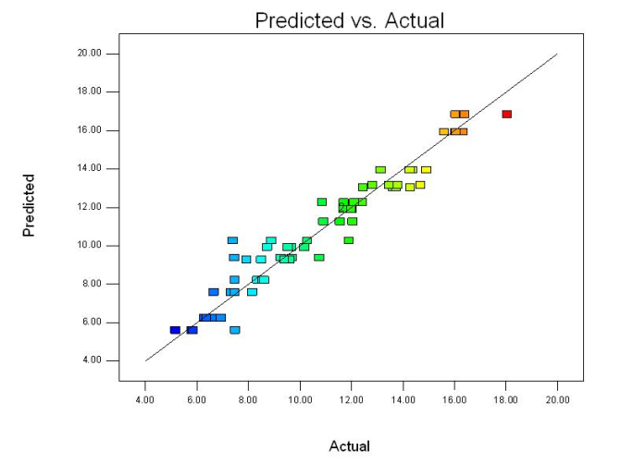
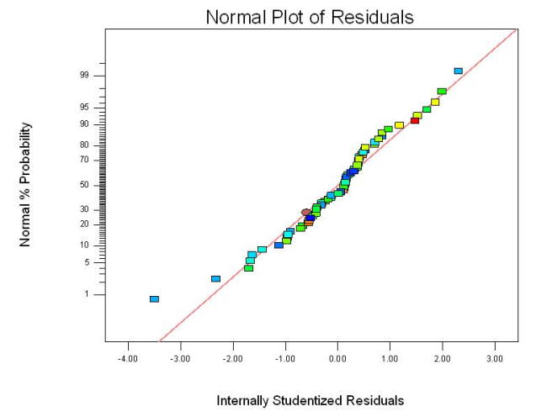
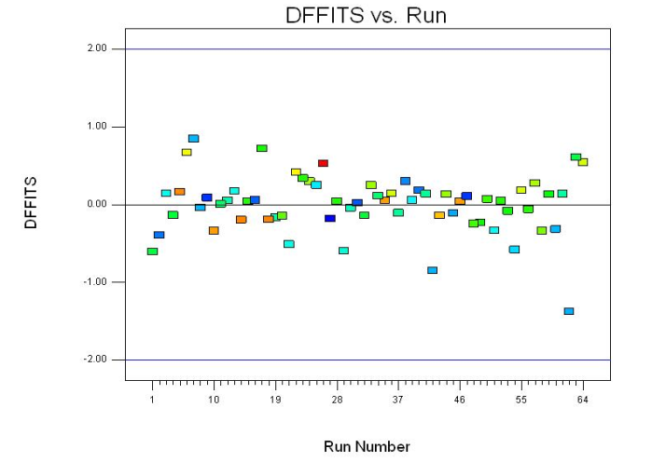
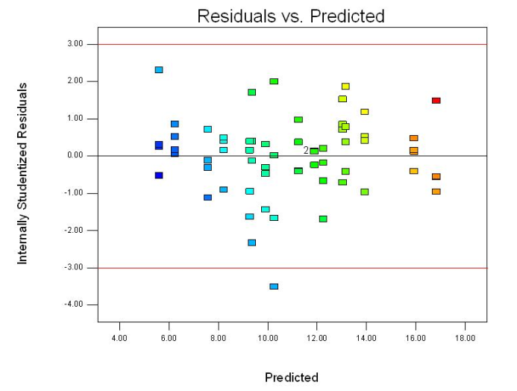
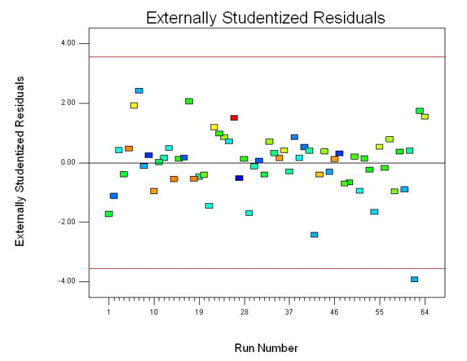
Experimental Design Approach Step 6 – Diagnostics (Case II)
Design
2⁵ Factorial
2 Replicates
Validating the data and the statistical assumptions.

Slide 16
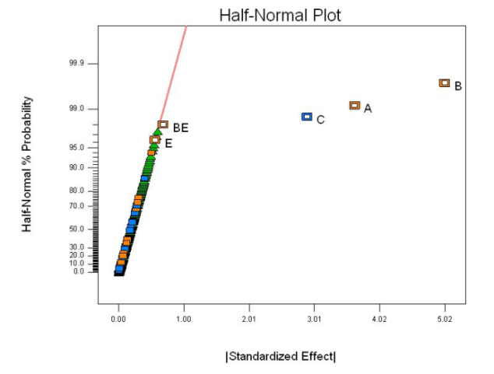
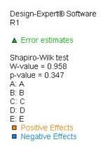
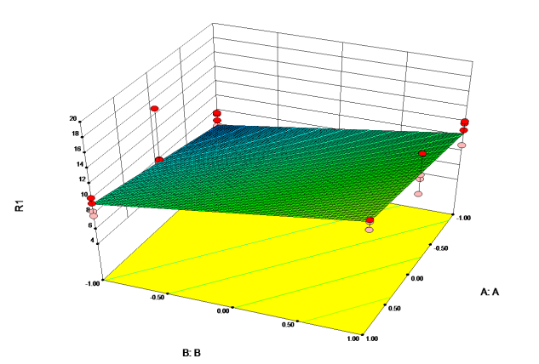
Experimental Design Approach Step 6 - Statistical Analysis (Case III)
Factors D and E are not significant.
Analysis of Variance Table for Case III (4 x 2⁵ Factorial + Center Points); p-value < 0.1
Sum of Mean F p-value Source Squares df Square Value Prob > F
Model 1524.59 5 304.92 141.81 < 0.0001 significant A 423.11 1 423.11 196.78 < 0.0001 B 636.09 1 636.09 295.83 < 0.0001 C 191.10 1 191.10 88.88 < 0.0001 E 2.90 1 2.90 1.35 0.2467 BE 15.04 1 15.04 7.00 0.0089 Curvature 22.76 8 2.84 1.32 0.2346 not significant Residual 382.73 178 2.15 Lack of Fit 52.47 34 1.54 0.67 0.9112 not significant Pure Error 330.26 144 2.29 Cor Total 1930.08 191
Reduced Empirical Model (Adjusted, Coded Factors)
R = I + x₁A + x₂B –x₃C +x5E + x₂₅BE
R² = 0.7899 Adj. R² = 0.7843 Pred. R² = 0.7775 Adeq. Precision = 40.9
* Ref: Design Expert 8.0.7.1

Slide 17
Experimental Design Approach Step 6 - Confirmation
Save a few runs for confirmation.
Case I Case II
Empirical Error
A | B | C | E | Case I | Case II
0 | -1 | -1 | -1 | 13.8 | 5.1
0 | -1 | -1 | 1 | 10.9 | 0.7
0 | -1 | 1 | -1 | 9.0 | 3.0
0 | -1 | 1 | 1 | 0.2 | 1.6
0 | 1 | -1 | -1 | 7.1 | 1.6
0 | 1 | -1 | 1 | 4.3 | 1.4
0 | 1 | 1 | -1 | 13.6 | 0.6
0 | 1 | 1 | 1 | 3.2 | 2.0
Average |  |  |  | 7.8 | 2.8
+
+
E
E
–
–
C
A
C
A
–
D
+
B
–
D
+
B
Factor A was a 3-level factor.
The designs for Case I and Case II used only the high and low settings (in blue), and not the center points (in red).
The center points were used for confirmation.
The Empirical Error is the difference between the average (5 runs) at the center points and the respective model predictions for those factor settings.
“ All models are wrong, but some are useful. “
George Box

Slide 18
Experimental Design Approach Test 2
D = -1
E = 1
D = -1
E = -1
D = 1
E = -1
D = 1
E = 1
D = -1
D = 1
Improvements
Screening the factors resulted in 50% reduction in runs from test to test.
2³ CRD on A, B, C
2³ CRD on A, B, C
2³ CRD on A, B, C
2³ CRD on A, B, C
2³ CRD on A, B, C
2³ CRD on A, B, C
Test 1
Test 2

Slide 19
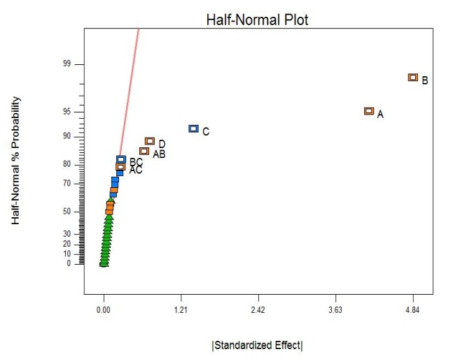
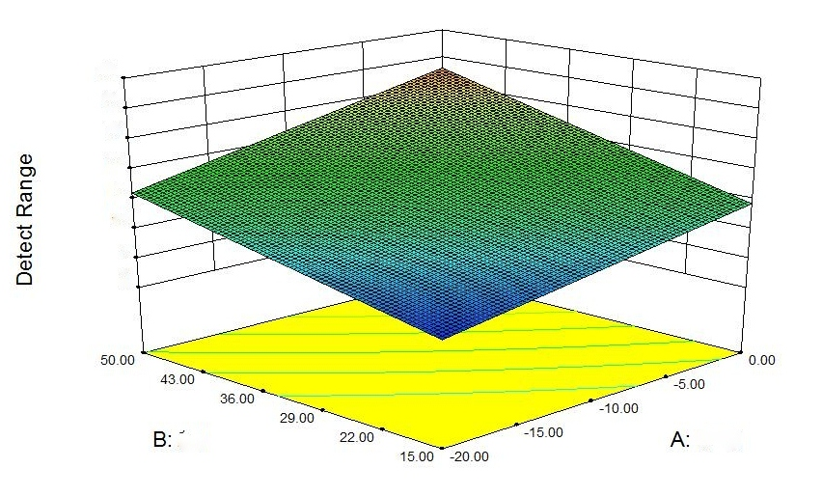
Experimental Design Approach Step 6 - Statistical Analysis (Case II, Test 2)
Analysis of Variance Table for Test 2 (2 x 2⁴ Factorial); p-value < 0.1
Sum of Mean F p-value Source Squares df Square Value Prob > F
Model 350.07 7 50.01 310.41 < 0.0001 significant
A 137.99 1 137.99 856.50 < 0.0001 B 187.65 1 187.65 1164.74 < 0.0001 C 15.83 1 15.83 98.29 < 0.0001
D 4.20 1 4.20 26.06 < 0.0001 AB 3.23 1 3.23 20.06 0.0002
AC 0.58 1 0.58 3.57 0.0710 BC 0.59 1 0.59 3.67 0.0674 Residual 3.87 24 0.16 Lack of fit 1.68 8 0.21 1.53 0.2231 not significant
Pure Error 2.19 16 0.14
Cor Total 353.93 31
Factors D now is significant.
Reduced Empirical Model (Coded Factors)
R = I + x₁A + x₂B – x₃C + x₄D + x₁₂AB + x₁₃AC – x₂₃BC
R² = 0.9891 Adj. R² = 0.9859 Pred. R² = 0.9806 Adeq. Precision = 55.5
* Ref: Design Expert 8.0.7.1

Slide 20
Experimental Design Approach Step 6 - Statistical Analysis (Comparison)
ANOVA Table for the split-plot experiment (Test 1 vs. Test 2)
Source | dof | SS | MS | F₀ | F | Significant
R (Test) | 1 | 16.02 | 16.02 | 330.90 | 10.13 | Significant
WP Error | 2 | 0.10 | 0.05 | 0.35 | *
A | 1 | 119.74 | 119.74 | 872.03 | 4.38 | Significant
B | 1 | 147.15 | 147.15 | 1071.65 | 4.38 | Significant
C | 1 | 27.08 | 27.08 | 197.25 | 4.38 | Significant
AB | 1 | 3.45 | 3.45 | 25.09 | 4.38 | Significant
AC | 1 | 0.00 | 0.00 | 0.03 | 4.38 | Not significant
BC | 1 | 1.16 | 1.16 | 8.41 | 4.38 | Significant
RA | 1 | 0.26 | 0.26 | 1.89 | 4.38 | Not significant
RB | 1 | 1.73 | 1.73 | 12.60 | 4.38 | Significant
RC | 1 | 2.99 | 2.99 | 21.77 | 4.38 | Significant
SP Error | 19 | 2.61 | 0.14 | * | * | *
 | 31 | 322.28
A split-plot design was used to compare detection performance between the tests. Factor R is significant—there is a difference between the radar systems.

Slide 21
Summary
Experimental design is the integration of well defined and structured scientific strategies for gathering empirical knowledge using statistical methods for planning, designing, executing, and analyzing a test.
Experimental design provides a comprehensive understanding of the tradeoffs in the techno-programmatic domains: risks, cost, and utility of information.
Experimental design can help reducing test assets, shortening the test schedule, and providing more information to the warfighter and decision makers.
Experimental design adds rigor and discipline to T&E.

Slide 22
Conclusions
What could we have done differently?
Only 16 runs.

Slide 23
References
Bisgaard, S., Fuller, H. T., & Barrios, E. (1996). Quality quandaries: Two-level factorials run as split-plot experiments. Quality Engineering, 8, 705-708
Coleman, D. D., & Montgomery, D. C. (1993). A systematic approach to planning for a designed industrial experiment. Technometrics, 35, 1-12.
Cortes, L. A., & Bergstrom, D. (2012). Using design of experiments for the assessment of surface radar detection performance and compliance with critical technical parameters. 80th MORS Symposium, June 2012.
Fisher, R. A. (1962). The place of the design of experiments in the logic of scientific inference. Colloques Internationaux du Centre National de la Recherche Scientifique, 110, 13-19.
Freeman, L. J., Ryan, A. G., Kensler, J. L. K., Dickinson, R. M., & Vining, G. G. (2013). A tutorial on the planning of experiments. Quality Engineering, 25, 315-332.
Johnson, R. T., Hutto, G. T., Simpson, J. R., & Montgomery, D. C. (2012). Designed experiments for the defense community, Quality Engineering, 24, 60-79.
Montgomery, D. C. (2013), Design and Analysis of Experiments,8th ed., John Wiley & Sons.
Simpson, J. R., Listak, C. M., & Hutto, G. T. (2013). Guidelines for planning and evidence for assessing a well-designed experiment. Quality Engineering, 25, 316-355.

Slide 24
Knowledge, insight, and value

